Slide 1

GROUP 5
TEAM MEMBERS :
ANIRVIN VISHWANATHAN
KANISHKA KOTHARI
AKASH MAHALE
MENTOR:
Dr. PREETIDA JANI

Slide 2
TOPIC:
GENERATING A DECENTRALIZED ARCHITECTURE FOR DATA PRIVACY AND SHARING USING BLOCKCHAIN TECHNOLOGY

Slide 3
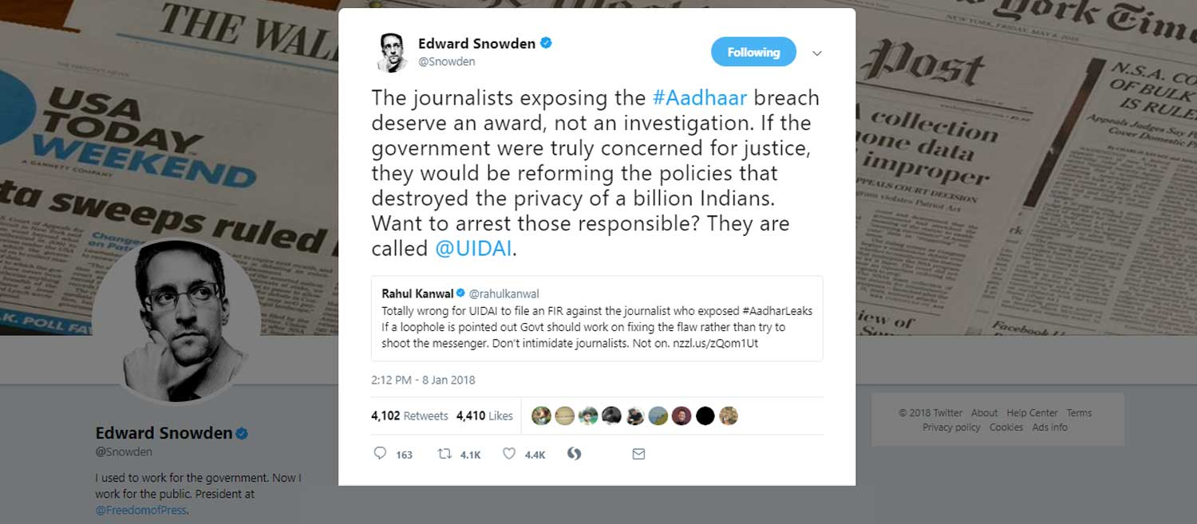

Slide 4
LITERATURE SURVEY
KYC Optimisation Using Distributed Ledger Technology(Jose Parra-Moyano and Omri Ross). | The know-your-customer (KYC) process is outdated and generates high costs of processing. The paper proposes a new system, based on Blockchain technology.
Blockchain Orchestration and Experimentation Framework: A Case Study of KYC(Jerome Francois, Wazen Shbair, Radu State). | Conducting experiments to evaluate blockchain applications is a challenging task for developers, because there is a range of configuration parameters that control blockchain environment.
Double-Blind Consent-Driven Data Sharing on Blockchain(Kumar Bhaskaran, Peter Ilfrich, Dain Liffman). | The paper describes the design and implementation of a smart contract for consent-driven and double-blind data sharing and shows how a KYC application was built around this model.
Model Driven Regulatory Compliance : A Case Study of “Know Your Customer” regulations( Sagar Sunkle, Deepali Kholkar, Vinay Kulkarni) | KYC regulations in Indian context as a case study, we demonstrate the utility of this architecture. Initial results with KYC regulations are promising and point to further work in model-driven regulatory compliance.

Slide 5
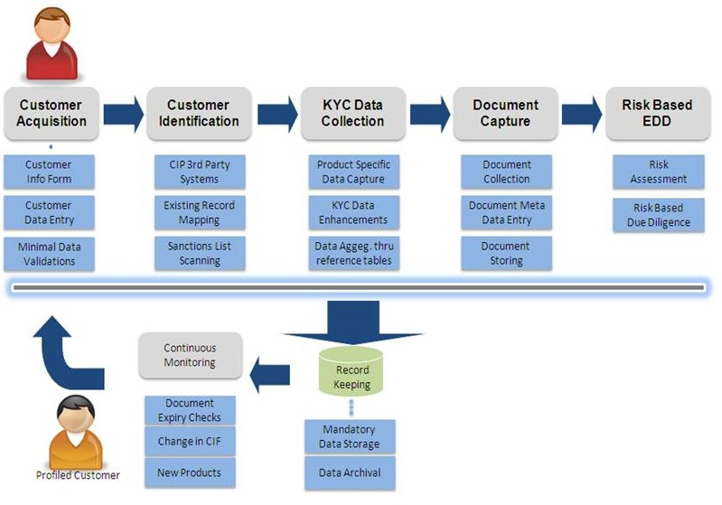
CURRENT KYC PROCESS:
Validation of client’s identity - Involves submission of various documents.
Cross-checking the documents.
Certification of the client
Keeping a record of client data.
Repetitive monitoring of client.
WITH REFERENCE TO-
Model-driven regulatory compliance: A case study of “Know Your Customer” regulations (Sagar Sunkle, Deepali Kholkar, Vinay Kulkarni)’
Blockchain orchestration and experimentation framework: A case study of KYC (Jerome Francois, Wazen Shbair, Radu State).

Slide 6
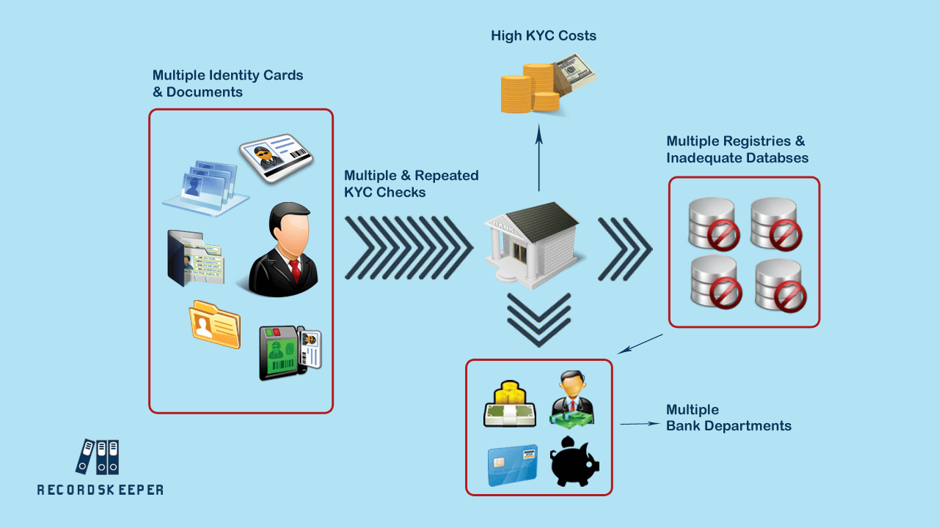
PROBLEMS IN CURRENT KYC PROCESS:
Manual Process -
a. Increased time consumption.
b. Error prone.
Submission of multiple documents containing similar information.
Repetitive checks for data updation.
Intra bank departments asking for similar information from customer.
Inter bank KYC scheme isn’t followed.
RESULT- HIGH COSTS AND LOW CUSTOMER SATISFACTION
WITH REFERENCE TO-
Double-Blind Consent-Driven Data Sharing on Blockchain(Kumar Bhaskaran, Peter Ilfrich, Dain Liffman).
KYC Optimisation Using Distributed Ledger Technology(Jose Parra-Moyano and Omri Ross).

Slide 7
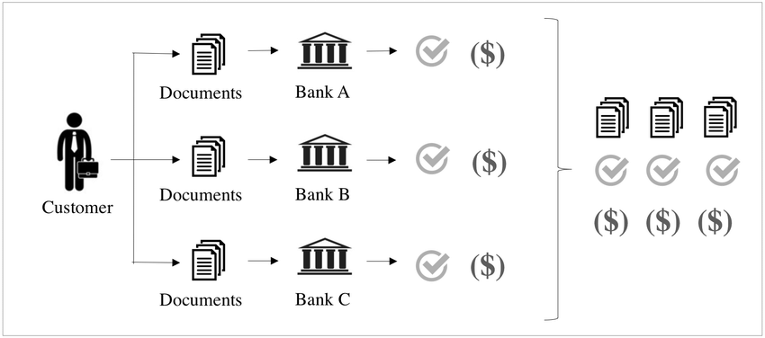
KYC Optimisation Using Distributed Ledger Technology(Jose Parra-Moyano and Omri Ross):
PROBLEM ENCOUNTERED IN THE CURRENT SYSTEM

Slide 8
OBJECTIVES
A Decentralised architecture - serving as 3rd Party Service
Blockchain for Data privacy
RFID/ Biometrics for Authentication
A protected Database of E-KYCs for data sharing

Slide 9
WHY BLOCKCHAIN
Distributed: The ledger is replicated across a number of computers, rather than being stored on a central server. Any computer with an internet connection can download a full copy of the blockchain.(Decentralized and Shareable)
Cryptographic: Cryptography (SHA-256) is used to make sure that the customer data is safe and hackers aren’t able to misuse the sensitive data. (Privacy)
Immutable: The blockchain can be changed in append only fashion. In other words, new customer data can only be added to the blockchain but cannot be deleted or modified. (Updation)

Slide 10
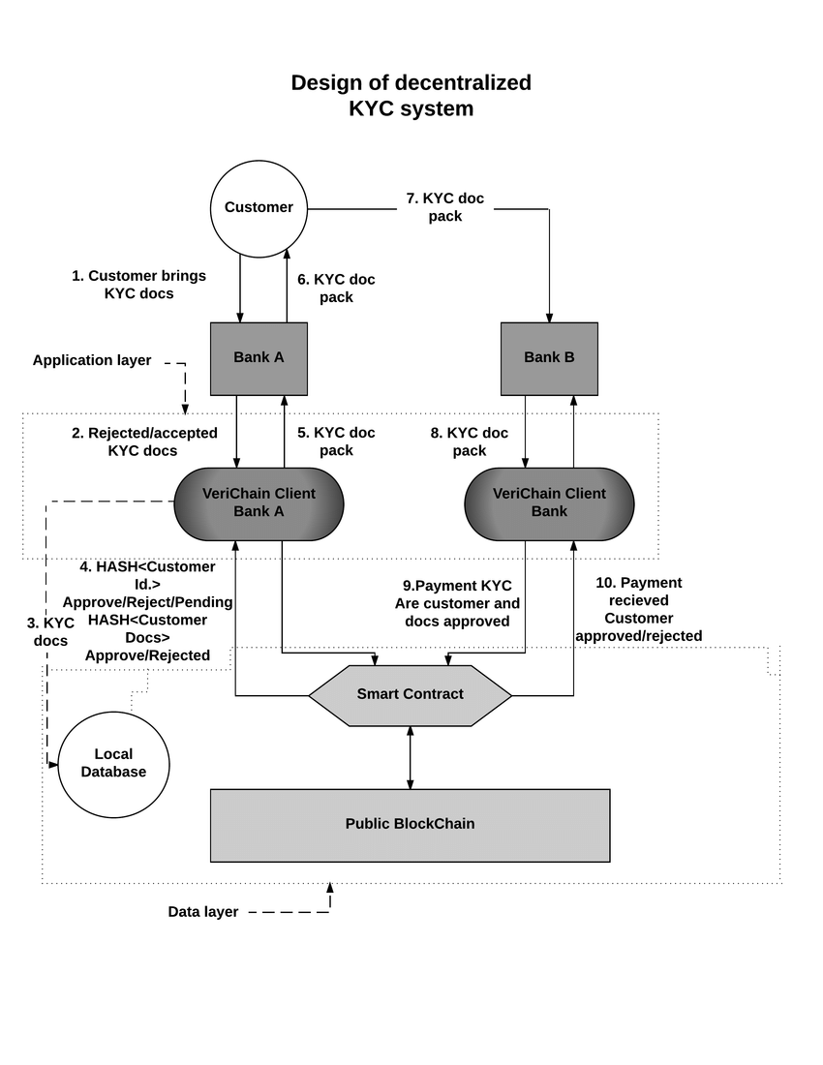
OUR ARCHITECTURE

Slide 11
WHO ARE OUR CUSTOMERS
Anyone who deals with KYC.
Banks-Home Loan Melas
Mutual Funds- AMFI
Airlines-Digital Marketing
Mobile Network Operator-Innovative Labs
Aadhaar Card-UIADI
Digitize India Platform

Slide 12
PLANNING
Understanding of Blockchain and KYC process , objective of project (done) | August ’18
Creating a sample database of info. and encrypting it | October ’18
Adding the encrypted data in blockchain and other processes | December ’18
Using Biometrics for authentication | January ’19
Implementing IOT module for data sharing and other R & D | March ’19

Slide 13
REFERENCES (1/3)
V. Gatteschi, F. Lamberti, C. Demartini, C. Pranteda and V. Santamaría, "To Blockchain or Not to Blockchain: That Is the Question," in IT Professional, vol. 20, no. 2, pp. 62-74, Mar./Apr. 2018.
T. Aste, P. Tasca and T. Di Matteo, "Blockchain Technologies: The Foreseeable Impact on Society and Industry," in Computer, vol. 50, no. 9, pp. 18-28, 2017.
doi: 10.1109/MC.2017.3571064
H. Beyadar and K. Gardali, "The study of customer relationship management method," 2011 5th International Conference on Application of Information and Communication Technologies (AICT), Baku, 2011, pp. 1-4.
F. Wang and Y. Zhang, "Study and Design of Intelligent Authentication System Based on Fingerprint Identification," 2009 Second International Symposium on Knowledge Acquisition and Modeling, Wuhan, 2009, pp. 170-173.
W. M. Shbair, M. Steichen, J. François and R. State, "Blockchain orchestration and experimentation framework: A case study of KYC," NOMS 2018 - 2018 IEEE/IFIP Network Operations and Management Symposium, Taipei, 2018, pp. 1-6.

Slide 14
REFERENCES (2/3)
K. Bhaskaran et al., "Double-Blind Consent-Driven Data Sharing on Blockchain," 2018 IEEE International Conference on Cloud Engineering (IC2E), Orlando, FL, 2018, pp. 385-391.
S. Sunkle, D. Kholkar and V. Kulkarni, "Model-driven regulatory compliance: A case study of “Know Your Customer” regulations," 2015 ACM/IEEE 18th International Conference on Model Driven Engineering Languages and Systems (MODELS), Ottawa, ON, 2015, pp. 436-445.
P. C. Mondal, R. Deb and M. N. Huda, "Know your customer (KYC) based authentication method for financial services through the internet," 2016 19th International Conference on Computer and Information Technology (ICCIT), Dhaka, 2016, pp. 535-540.
P. C. Mondal, R. Deb and M. N. Huda, "Know your customer (KYC) based authentication method for financial services through the internet," 2016 19th International Conference on Computer and Information Technology (ICCIT), Dhaka, 2016, pp. 535-540
S. Sunkle, D. Kholkar and V. Kulkarni, "Model-driven regulatory compliance: A case study of “Know Your Customer” regulations," 2015 ACM/IEEE 18th International Conference on Model Driven Engineering Languages and Systems (MODELS), Ottawa, ON, 2015, pp. 436-445.

Slide 15
REFERENCES
Risks around correctly authenticating validating and verification: https://www.chartis-research.com/financial-crime/spotlight-kyc-1148
Documents required for KYC -
https://www.goodreturns.in/classroom/2016/01/what-is-kyc-what-are-the-documents-required-kyc/articlecontent-pf9460-42203
Digital platform for Indian Product- https://digitizeindia.gov.in/
Understanding of KYC and its guidelines
-http://www.ijsrp.org/research-paper-0713/ijsrp-p1989.
Description of Association of Mutual Funds Of India: https://www.amfiindia.com/

Slide 16
THANK YOU !!

